Slide 1
Vulnerability of Complex System
Lokaltermin des ETH-Präsidenten
Mittwoch, 1. Juli 2009
Laboratory for Safety Analysis

Slide 2
Major challenge : From reliability and risk engineering of complicated systems ...
Problems:
• Numerous variables, highly integrated
• Structure stable over time, low dynamics
• Analytical thinking and diligence sufficient
Methods:
• Decomposition of systems, causal chains;
PSA framework
• Further developments required, e.g. human
factors, common cause failures

Slide 3
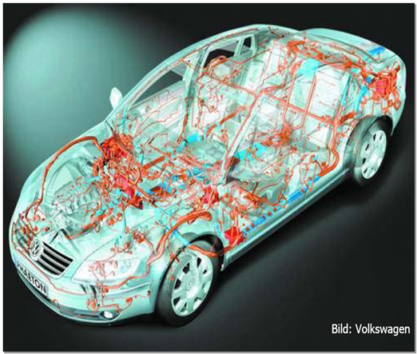
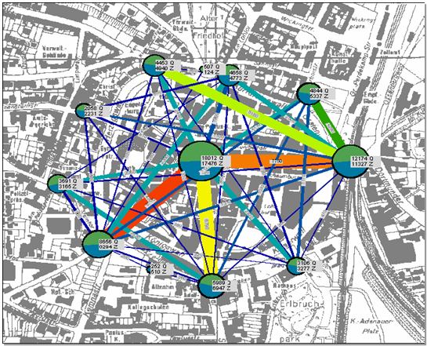
... to vulnerability assessment of complex systems
Complex systems:
• Inadequate information about elements,
states and interactions
• Nonlinearities, feedback loops, adaptive
emergent behavior
Problems:
• System behavior unequal sum of single
elements’ behavior
• Strong interdependencies
Need to model and simulate „system-of-systems“

Slide 4


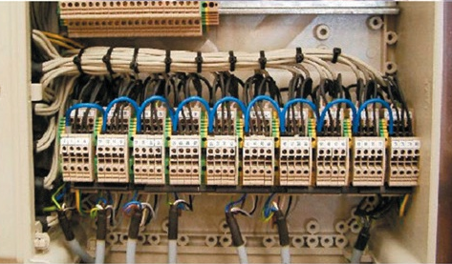
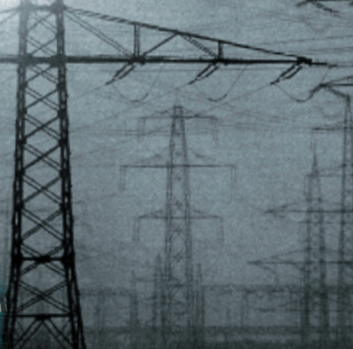

What if…
Drinking water is missing due to
  Electrical energy system break down due to
    Missing communication service due to
      Overloaded communication component due to
        Cyber attack due to
          …
    ⇒ Critical Infrastructure Protection (CIP)

Slide 5
Critical Infrastructures Interdependencies:
Scientific Support for Federal Office for Civil Protection
(red: high, green: low, yellow: medium)
Fig. Assessment matrix for five coupled infrastructures
current
started
Source: IRGC White Paper 3, 2006

Slide 6

Electric Power Systems: Italian Blackout 2003

Slide 7
Internet (infrastructure) security
Internet protocols were designed for an environment of trustworthy academic and government users with limited applications, not for global users.
Commercial off-the-shelf (COTS) software (the number of features and rapid time to market outweigh a thoughtful security design)
Monocultures of, individual and networked computers, applications, routers, switches and operating systems increase the effects of any threat:
  a single vulnerability can exist and be exploited in millions of identical copies of the same software and hardware

Slide 8
SCADA (real Swiss case) – search of potential hacker entry points
(3)
Dedicated data exchange between utilities and Swiss TSO (PIA system)
Trading/office systems separated from SCADA
  Own control systems – can be operated via own telephone lines; protective systems/devices independent from SCADA
(1)
(2)

Slide 9
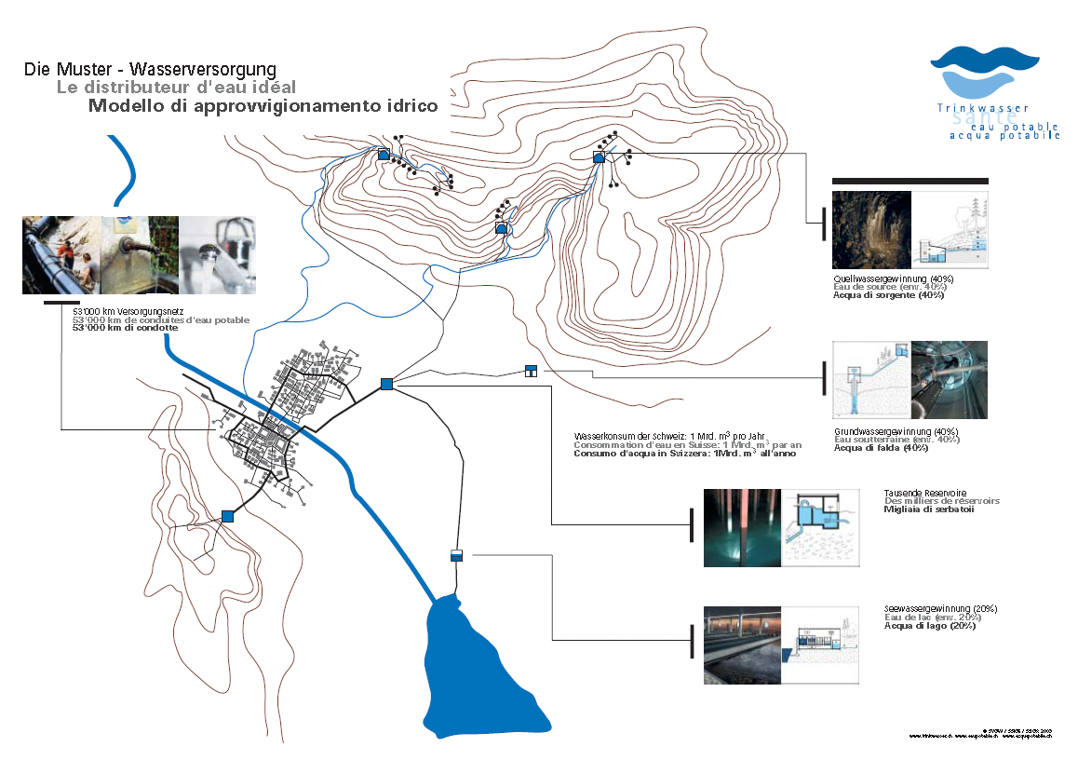

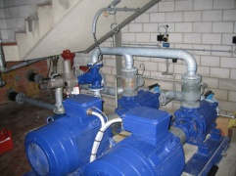
Drinking Water
© SVGW / SSIGE / SSIGA 2003; www.trinkwasser.ch

Slide 10
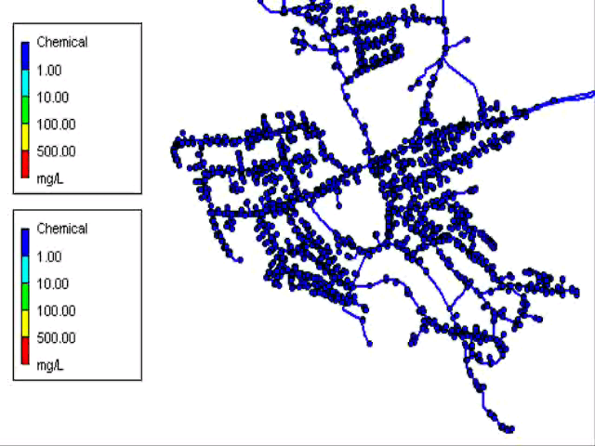
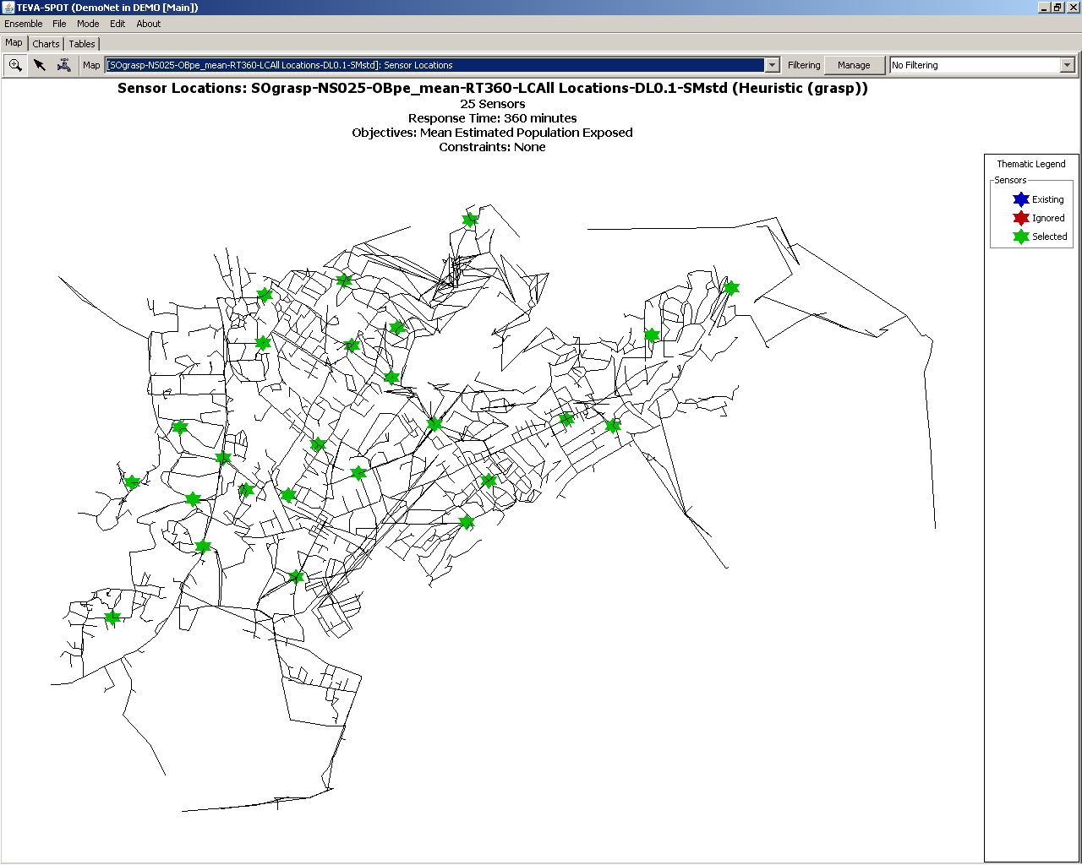
Water: Simulation of contamination
Scenarios
Contaminations
  Flow
  Concentration
Sensor placement

Slide 11
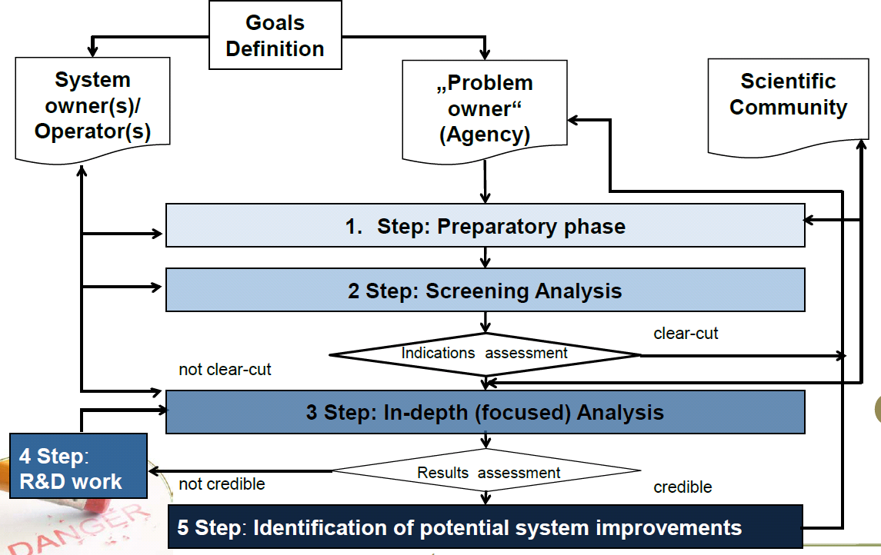
Methods: framework for vulnerability analysis

Slide 12

Method: Agent Based Modeling (ABM)
Goal
Memory
Has different states
(Finite State Machine, FSM)
Is capable of interaction with its environment (e.g. other objects)
has „receptors“ and „effectors“
for specific („messages“) and non-specific (environmental variables) signals
Can act randomly
May have a memory (learning)
Can strive for a goal
Intact
Repairing
Defect

Slide 13
Simulation of N objects
One single object does not tell us much about the behaviour of its macro-system
Therefore every component of a system has to be modelled separately by an object
By the computational simulation of all objects, the global system behaviour and the system states emerge
Intact
Repairing
Defect

Slide 14
Agent-based Modelling applied to the electric power system
Identify the components of the system.
Determine the states of each component by making use of FSM.
2. Establish the communication among the objects.
3. Simulate your model to generate the system states and estimate Blackout Frequencies
1. Das Konzept
2. Die Systemmodellierung
3. Die Simulation
Kumulative Ausfallswahrscheinlichkeit

Slide 15
Conclusions
Complex systems (e.g. CIs) face multiple threats (technical-human, natural, physical, cyber, contextual; unintended or malicious); may pose risks themselves
CIs show high complexity, inter-dependencies of different type, coupling and interaction level, e.g. through a host of industrial ICT
Vulnerability analysis of complex systems calls for ‘system-of-systems thinking’, suitable techniques and problem-oriented approach.
LSA has developted a comprehensive framework for vulnerability analysis of complex systems

